Slide 1
Proposed Global Grant Projects- RID3132, India
Presented by
Dr. Anup Karwa
District Grant Subcommittee Chair (DGSC)
District 3132, Jalna, India
Email: anupkarwa@gmail.com Ph: +919422721183

Slide 2
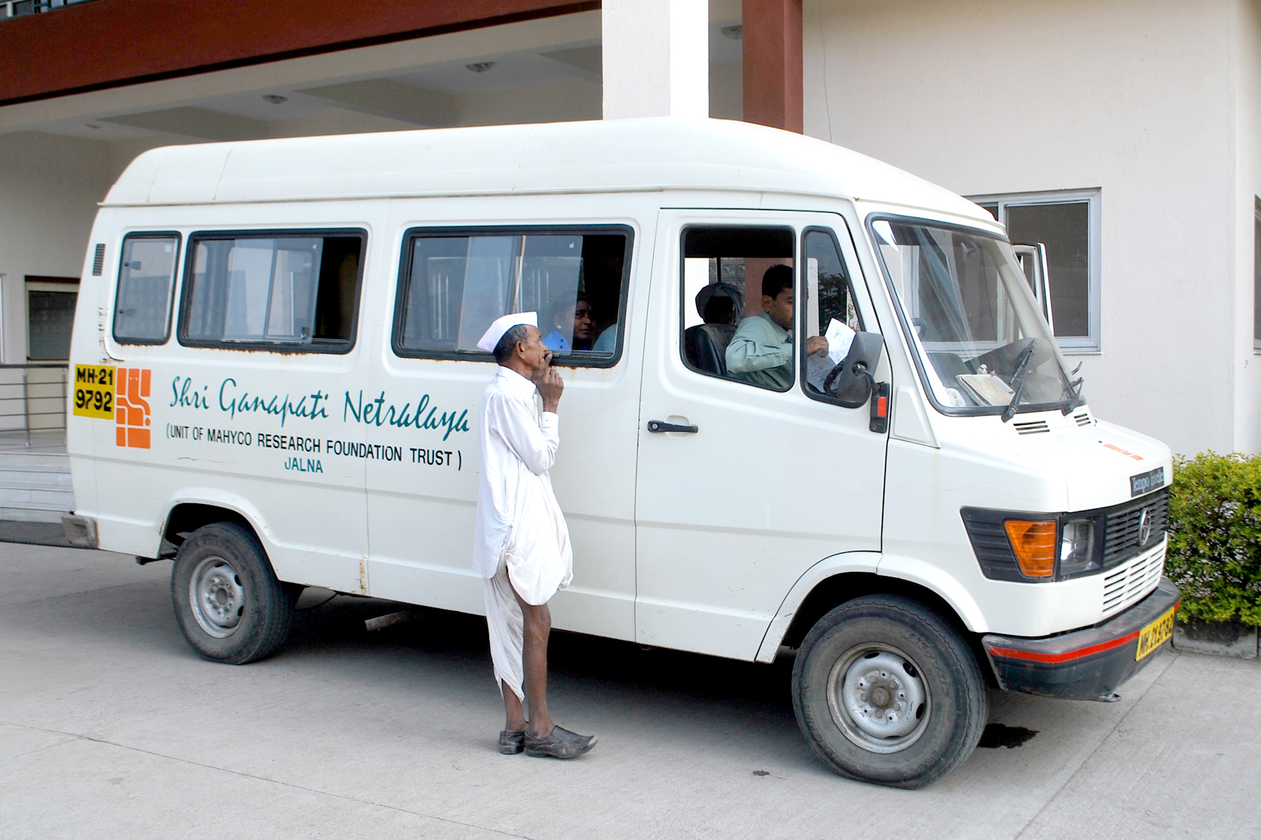
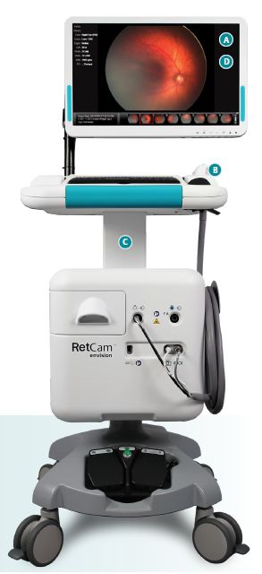
Diagnostic of Retinopathy for NICU, Pediatric Surgeries & Cataract Surgeries Camps
Synopsis:
Retinopathy of prematurity (ROP) is a vasoproliferative disease affecting the retinal vessels of premature infants (NICU) ~5000 children are affected and can lead to blindness if not diagnosed and treated.
3.5 million preterm infants are born in India & several affected with ROP.
Partner hospital will invest 80% for RETCAM (~180,000$), provide free mobile imaging van & even match the costs for cataract surgeries (~500).
Partner hospital & SightSavers India Foundation will conduct free surgeries for diseases covered under govt insurance scheme
Diagnostic camps for NICU & Cataract will be conducted across 5 locations in Maharashtra benefiting ~100,000 patients
Mobile Van with Cloud Imaging
Sr. No | Particular | Costs (USD)
1 | RETCAM (20% costs) | 20000
2 | Diagnostic Camps | 14000
3 | Cataract Surgeries ~500 patients | 14000
4 | Contingency & Project Management | 2500
Total |  | 50500
Sr. No | Source of Funds | Amount (USD)
1 | Cash contribution RID3132 | 6000
2 | DDF- RID3132 (2500) | 4500
3 | DDF & Cash International club | 25000
4 | DDF & cash from other partner clubs | 15000
Total |  | 50500
RETCAM

Slide 3
GG Partnership on Retinopathy NICU & Cataract Surgeries
RID 3132,Jalna , Rotary Club of Jalna Midtown
Proposed Corona Rotary Club

Slide 4
Community assessment
India accounts for 10% of the Global Retinopathy of Prematurity According to a study from a tertiary Center in South India, trend in 2000-2017,a 20-fold increase in number of children diagnosed with ROP.
A cost of Illness study in India sing Gross National Income(GNI), estimated burden of Blindness and vision impairment is 845 billion in INR

Slide 5
Shri Ganpati Netralaya Jalna is State of the art tertiary eye care center run by Mahyco Reseach Foundation Trust providing services to the community for 30 years
It has the trained expert man power.
It has the necessary Equipments to diagnose and treat the ROP.
The Widefield Imaging with Mobile Fundus Camera in Community settings with a limited trained workforce and vast geographical are more suitable for addressing ROP in community

Slide 6
Proposed Screening and treatment Model
Trained staff will carry the Imaging Camera to various district Hospitals/Medical colleges not having the expertise to screen and treat ROP cases.
Trained Imaging staff capture the images using widefield high resolution Camera.
Images served in cloud based Servers.
Opthamologists from the center view images in Real-Time
On their smart phones.

Slide 7
Required Resources
Widefield Imaging Camera (need to procure).
Airconditioned vehicle with Drivers to carry the Camera( available with the hospital)

Slide 8
RETCAM Brilliant imaging Lighting the way with confidence Seamless connectivity Collect, protect, and transfer data with ease Optimal efficiency Flexibility to focus on the patient Retcam Envisions: Features and Benefits 24” screen provide ease of use and improved workflow New handpiece includes Fluorescein Angiography(FAR) provides sharp visualization of circulation of Retinal Blood vessels, leaking vessel defects neovascularization and any other ophthalmic diseases and conditions RRetvision Features and Benefit

Slide 9
Removable lens

Slide 10
Budget
Ret cam
$20,000
Diagnostic camps
$14,000
Cataract surgeries (ROP)
500 infants $14,000
Contingency and Project Management $2500
Total Estimated Budget $50,500

Slide 11
Funding Projections
DDF RID 3132 $4500
+ World Fund $3600
Cash Contribution RID 3132 $6000
(DDF & Cash International club $21,400)
DDF $11,890
World Fund $9,512
Cash from other partner clubs $14,998
Total $50,500

